Slide 1
Nurture Community
Team Members:
Anubha Sharma
Arshdeep Kaur
Harjinder Gill
Tanya Agarwal
Shafkat Waheed
Roxy Leonard Palma
Priyam Dua
Avinash Gupta
P-13 Milestone 2

Slide 2
Milestone 3
Localization Search
Read/Update/Delete Food Item

Slide 3


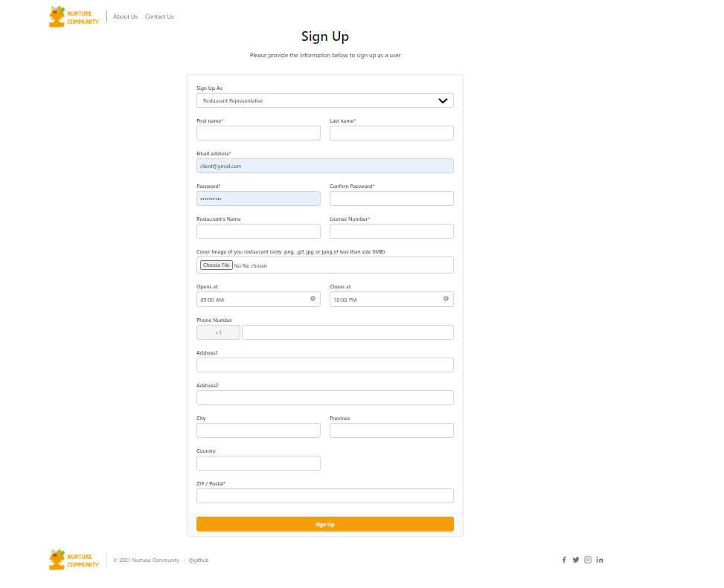

Signup Page for Restaurant representative
A new Restaurant representative adds the necessary details to register, and the details will be validated and stored in Azure data studio.
After successful registration, the Signup page emails the registered user and redirects to the Login page to check the Id and password entered in the Signup page.
Responsive Design: The page responds to changes in browser width by adjusting the placement of the input tabs and the buttons to fit in the available space.

Slide 4
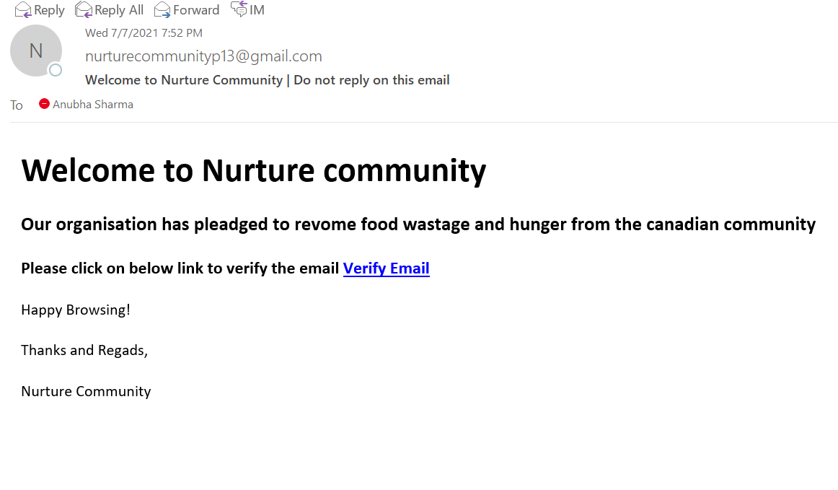
Validation On Sign Up Page
After the successful signup an email is sent to the user for the verification process. The verification part is in progress and will be completed in the 4th sprint.
Basic email validation and minimum password length of 8 digits.
Password is stored in the encrypted format in the database for security purpose.

Slide 5
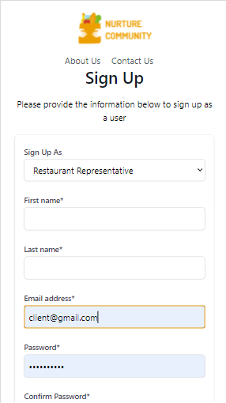
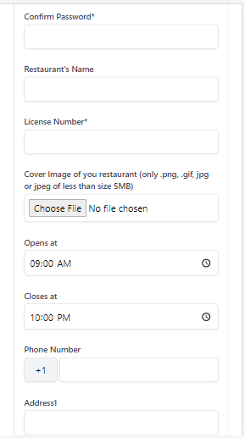
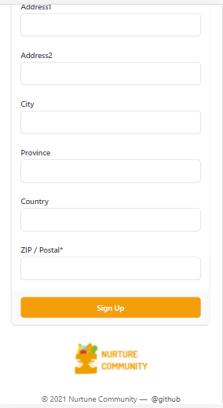
Mobile View of Sign Up Page:

Slide 6
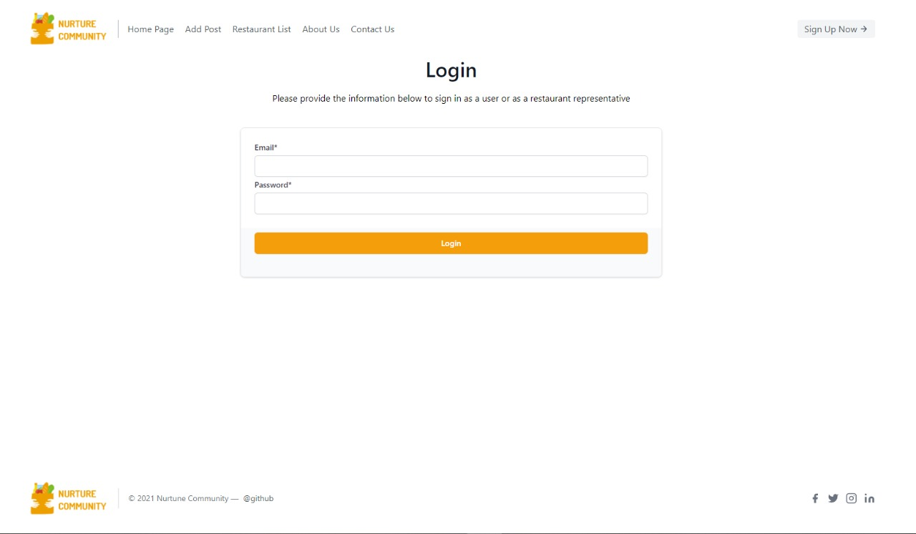
Login Page for Restaurant representative
The Restaurant representative that is already registered adds the necessary details to login, the details entered will be validated and verified.
Detects and inform whether Caps Lock is on by the user.
If the password is wrong, the system will alert the user about it and ask them to enter again.

Slide 7
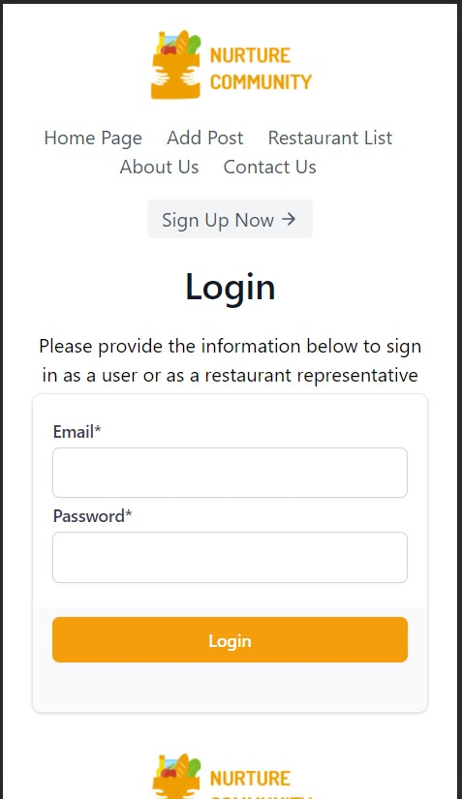
Mobile View of our Login Page:

Slide 8
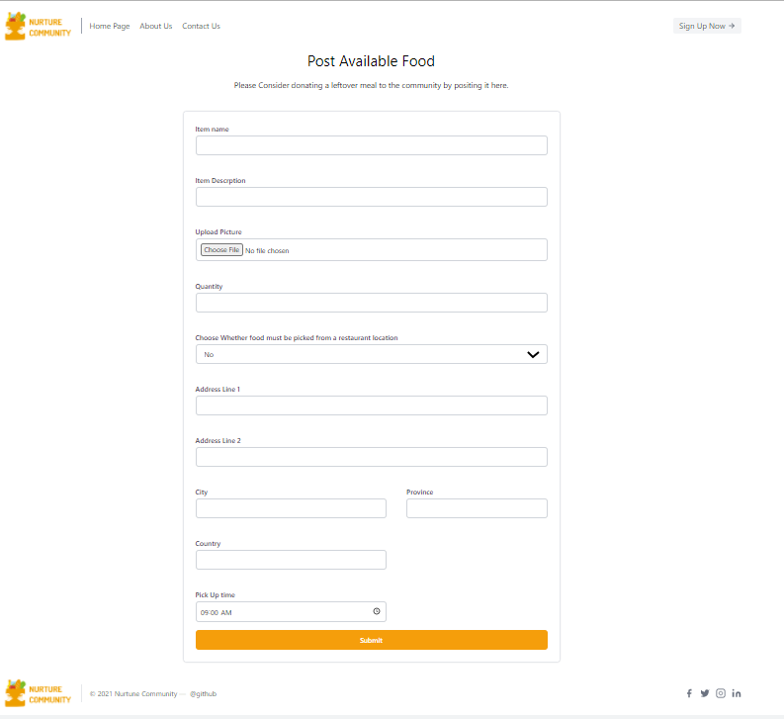
Add Post Available Food
This will be used by the restaurants to add the available food items, along with its detailed information.

Slide 9
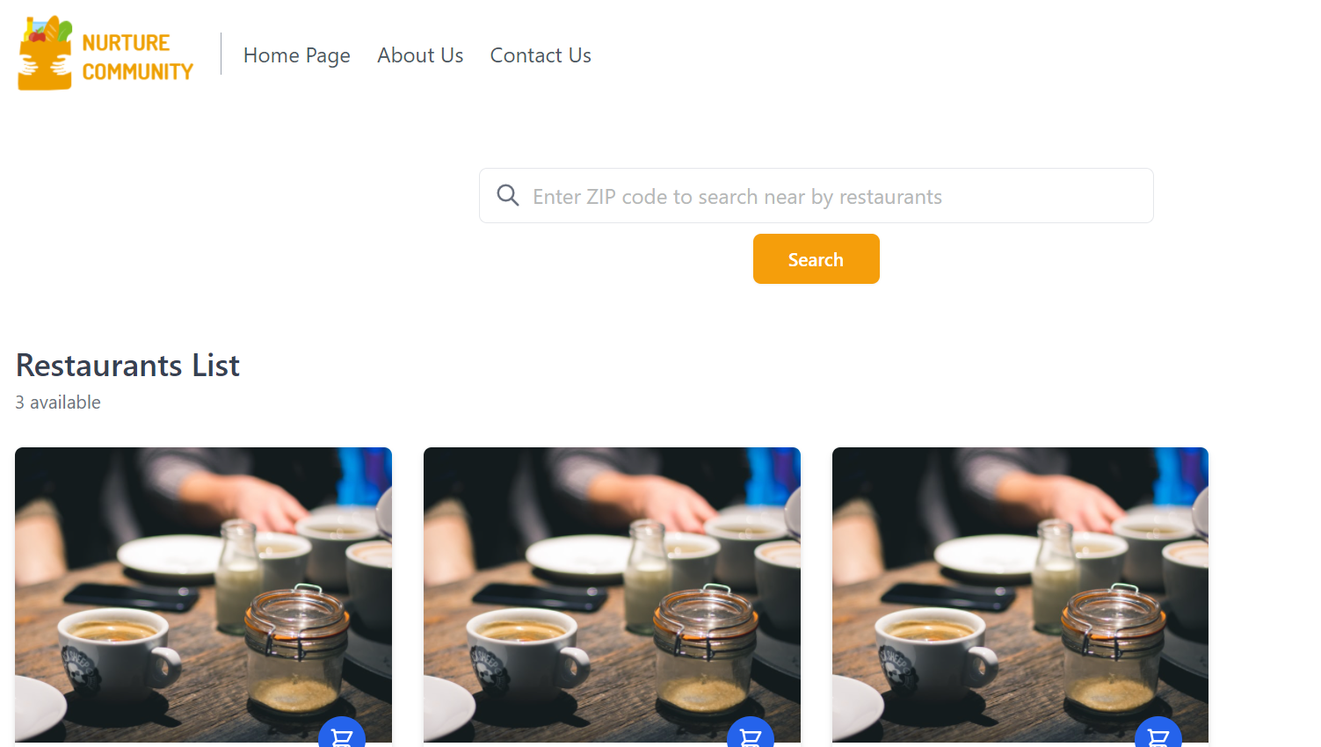
Restaurants List Page
After a user has successfully logged in, the list of restaurants will be available.
In the search bar the user can enter the zip code and all the restaurants for that zip code will be shown to the user.
The page will be updated and new data will be available when the restaurant representative register with restaurant details.

Slide 10
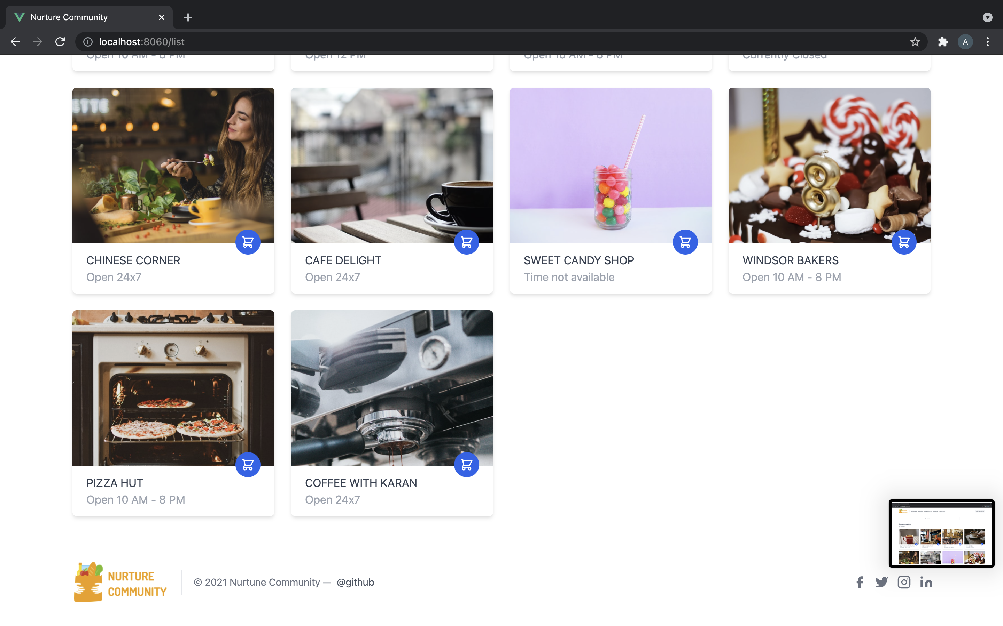
Restaurants List Page

Slide 11


